Slide 1
The Analysis of Repeated Measures Data
• The multivariate data sets considered in previous chapters have involved measurements or observations on a number of different variables for each object or individual in the study.
subject | age | # year ed | maths | english | history | geography | chemistry | physics
1 | 18 | 12 | 60 | 70 | 75 | 58 | 53 | 42
2 | 20 | 11 | 80 | 65 | 66 | 75 | 70 | 76
3 | 29 | 14 | 53 | 60 | 50 | 48 | 45 | 43
4 | 25 | 13 | 85 | 79 | 71 | 77 | 68 | 79
5 | 22 | 10 | 45 | 80 | 80 | 84 | 44 | 46
6 | 24 | 14 | 85 | 62 | 84 | 92 | 58 | 64
7 | 17 | 11 | 57 | 89 | 59 | 86 | 58 | 58
8 | 16 | 11 | 59 | 58 | 68 | 57 | 79 | 69
9 | 24 | 14 | 80 | 92 | 73 | 89 | 84 | 58
10 | 19 | 12 | 76 | 67 | 49 | 67 | 51 | 35

Slide 2
The Analysis of Repeated Measures Data
• The multivariate data sets considered in previous chapters have involved measurements or observations on a number of different variables for each object or individual in the study.
The following data set resulting from the repeated measurements of the same variable on each unit. These data come from a clinical trial in which individuals have been assigned to two treatment groups and have a response variable of interest recorded on days 1, 2, 5 and 7.
subject | age | # year ed | maths | english | history | geography | chemistry | physics
6 | 24 | 14 | 85 | 62 | 84 | 92 | 58 | 64
ID | Group | Day.1 | Day.2 | Day.5 | Day.7
1 | 1 | 15 | 15 | 10 | 7
2 | 1 | 10 | 9 | 11 | 12
3 | 1 | 8 | 7 | 6 | 9
4 | 2 | 11 | 8 | 13 | 7
5 | 2 | 11 | 12 | 11 | 11
6 | 2 | 12 | 12 | 6 | 10
The data “format” is called wide form

Slide 3
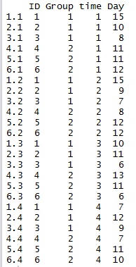
The Analysis of Repeated Measures Data
The individuals of the data have been assigned to two treatment groups and have a response variable of interest recorded on days 1, 2, 5 and 7.
ID | Group | Day.1 | Day.2 | Day.5 | Day.7
1 | 1 | 15 | 15 | 10 | 7
2 | 1 | 10 | 9 | 11 | 12
3 | 1 | 8 | 7 | 6 | 9
4 | 2 | 11 | 8 | 13 | 7
5 | 2 | 11 | 12 | 11 | 11
6 | 2 | 12 | 12 | 6 | 10
The data “format” is called long form
library("MVA")
ex_wide<-read.csv("D:/STAT 4400/Data/ex_wide.csv", header=TRUE)
reshape(ex_wide,direction="long",idvar="ID",varying=colnames(ex_wide)[-(1:2)])#create long form of the data

Slide 4
The Analysis of Repeated Measures Data
• The distinguishing feature of a repeated measures study is that the response
variable of interest has been recorded several times on each unit. In addition, a set of explanatory variables are available for each unit.
Explanatory
Response: Repeat four times on each unit
ID | Group | Day.1 | Day.2 | Day.5 | Day.7
1 | 1 | 15 | 15 | 10 | 7
2 | 1 | 10 | 9 | 11 | 12
3 | 1 | 8 | 7 | 6 | 9
4 | 2 | 11 | 8 | 13 | 7
5 | 2 | 11 | 12 | 11 | 11
6 | 2 | 12 | 12 | 6 | 10

Slide 5
The Analysis of Repeated Measures Data
The main objective in such a study is
How the explanatory variables associated with any change in the repeated values
To characterize change in the repeated values
explanatory
Repeated response values
Correlation between repeated values will be measured.
ID | Group | Day.1 | Day.2 | Day.5 | Day.7
1 | 1 | 15 | 15 | 10 | 7
2 | 1 | 10 | 9 | 11 | 12
3 | 1 | 8 | 7 | 6 | 9
4 | 2 | 11 | 8 | 13 | 7
5 | 2 | 11 | 12 | 11 | 11
6 | 2 | 12 | 12 | 6 | 10

Slide 6
The Analysis of Repeated Measures Data
The models for repeated measure data include
Parameters linking the explanatory variables to the repeated measurements
Parameters analogous to those in multiple Regression model
explanatory
Parameters that account for the correlational structure of the repeated measurements.
Repeated response values
ID | Group | Day.1 | Day.2 | Day.5 | Day.7
1 | 1 | 15 | 15 | 10 | 7
2 | 1 | 10 | 9 | 11 | 12
3 | 1 | 8 | 7 | 6 | 9
4 | 2 | 11 | 8 | 13 | 7
5 | 2 | 11 | 12 | 11 | 11
6 | 2 | 12 | 12 | 6 | 10

Slide 7
The Analysis of Repeated Measures Data
• The models for repeated measure data include
parameters linking the explanatory variables to the repeated measurements,
parameters analogous to those in the usual multiple regression model, and,
parameters that account for the correlational structure of the repeated measurements.

Slide 8
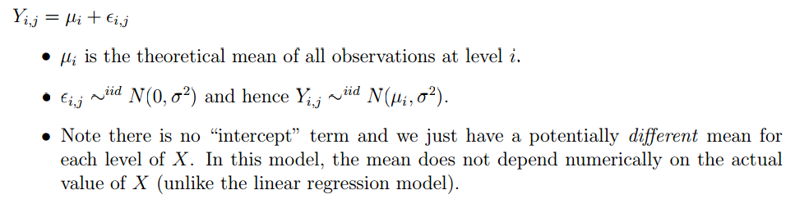
8.2 Linear mixed-effects models for repeated measures data
Review one-way ANOVA linear model learned from MATH 2040: whether the response differ significantly at different levels of X.

Slide 9
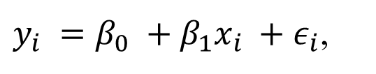
8.2 Linear mixed-effects models for repeated measures data
Review linear regression model learned from MATH 2040
$y_{i} =β_{0} +β_{1}x_{i} +ε_{i}$,

Slide 10
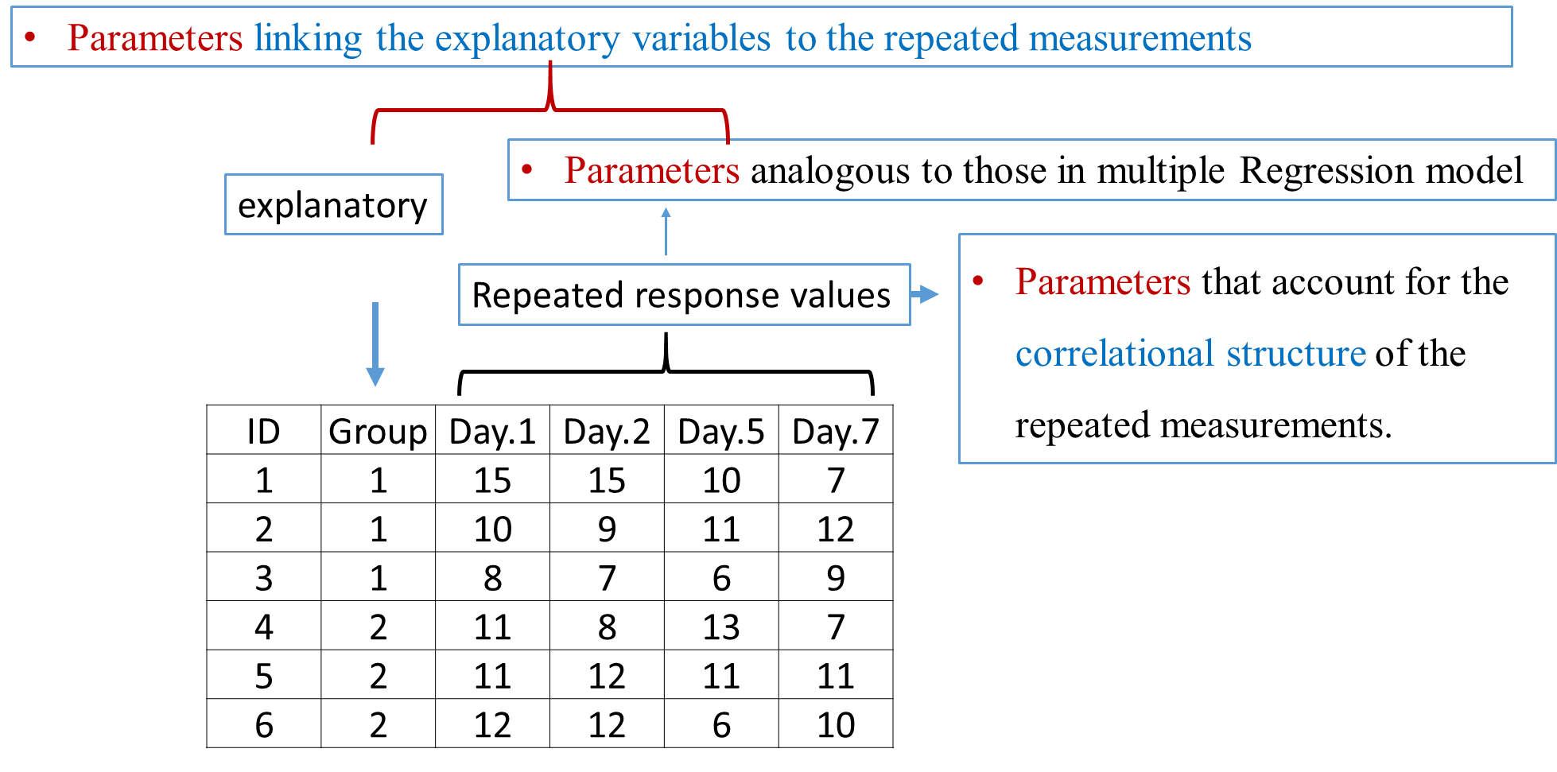

Slide 11

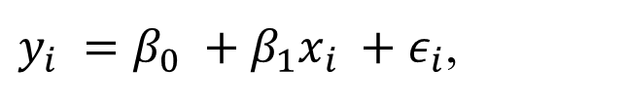
8.2 Linear mixed-effects models for repeated measures data
Review linear regression model learned
$y_{i} =β_{0} +β_{1}x_{i} +ε_{i}$,
If we choose to ignore the repeated measures structure of the, data we could t a simple linear regression model of the form
$$y_{ij} =β_{0} +β_{1}x_{j} +ε_{ij}$$
explanatory
Repeated response values
Repeated measurements are assumed to be independent, the so-called local independence assumption.
ID | Group | Day.1 | Day.2 | Day.5 | Day.7
1 | 1 | 15 | 15 | 10 | 7
2 | 1 | 10 | 9 | 11 | 12
3 | 1 | 8 | 7 | 6 | 9
4 | 2 | 11 | 8 | 13 | 7
5 | 2 | 11 | 12 | 11 | 11
6 | 2 | 12 | 12 | 6 | 10

Slide 12
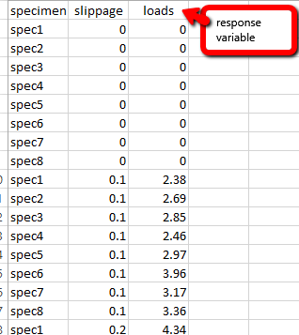
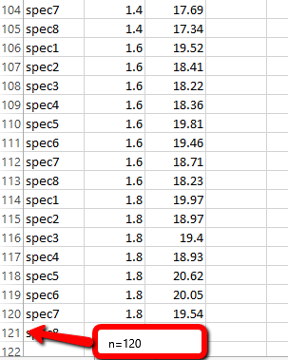
8.2 Linear mixed-effects models for repeated measures data
Review linear regression model learned
$y_{i} =β_{0} +β_{1}x_{i} +ε_{i}$,
If we choose to ignore the repeated measures structure of the, data we could t a simple linear regression model of the form
$$y_{ij} =β_{0} +β_{1}x_{j} +ε_{ij}$$

Slide 13
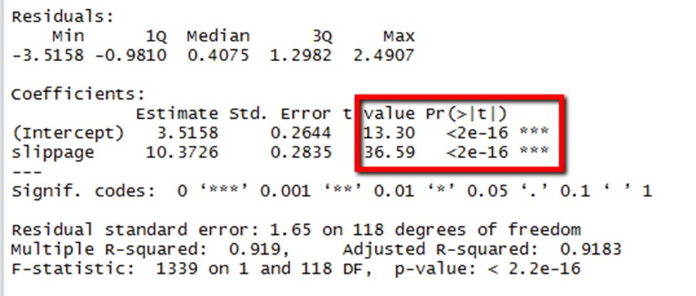
The slippage and loads are linear related.

Slide 14
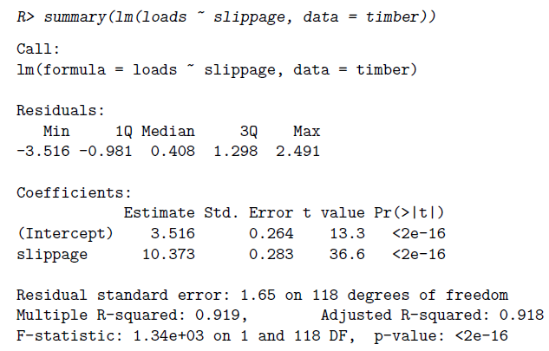

Such a model assumes that the repeated observations are independent of one another which is totally unrealistic for most repeated measures data sets.
${\hat{y}}_{ij}=3.516+10.373x_{j}$.
The slippage effect is large and highly Signiant.

Slide 15
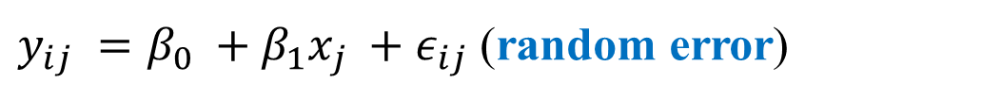
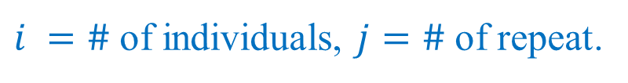
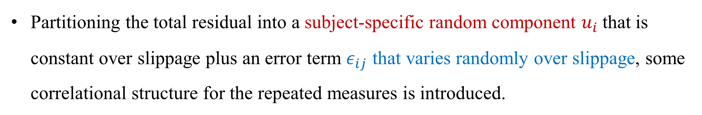


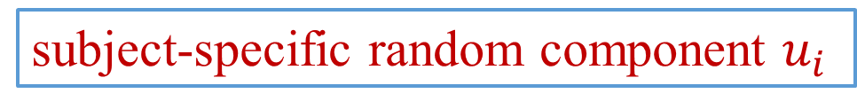
8.2 Linear mixed-effects models for repeated measures data
Modify regression model into the random intercept model
$y_{ij} =β_{0} +β_{1}x_{j} +ε_{ij}$ (random error)
subject-specific random component $u_{i}$
$$ε_{ij}$$
Partitioning the total residual into a subject-specific random component $u_{i}$that is constant over slippage plus an error term $ε_{ij}$ that varies randomly over slippage, some correlational structure for the repeated measures is introduced.
The random intercept model:
$$y_{ij} =(β_{0}+u_{i})+β_{1}x_{j} +ε_{ij}$$
$i =\#$of individuals, $j=\#$of repeat.

Slide 16
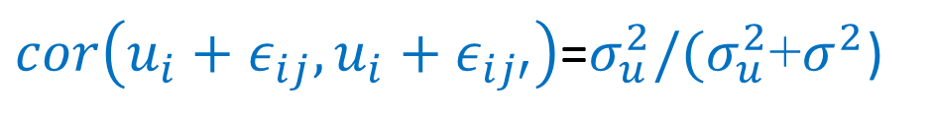
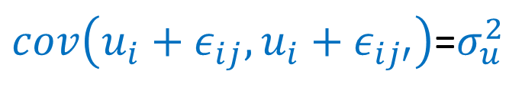

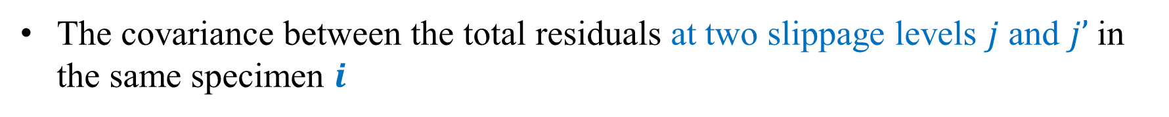
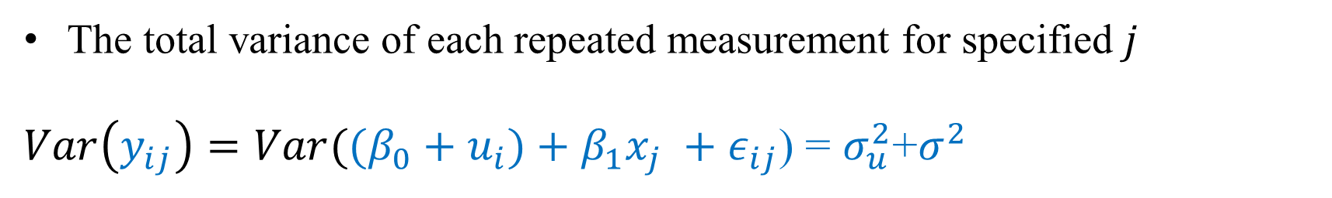
8.2 Linear mixed-effects models for repeated measures data
The random intercept model:
$$y_{ij} =(β_{0}+u_{i})+β_{1}x_{j} +ε_{ij}$$
$u_{i}\sim N\left(0,σ_{u}^{2}\right),ε_{ij}\sim N\left(0, σ^{2}\right),cov\left(u_{i},ε_{ij}\right)=0, cov\left(u_{i},x_{j}\right)=0$, $cov\left(ε_{ij},x_{j}\right)=0$
$u_{i}$allow for differences in the intercepts of each individual’s regression
The total variance of each repeated measurement for specified $j$
$Var\left(y_{ij}\right)=Var({(β_{0}+u_{i})+β_{1}x_{j} +ε_{ij}\text{) =} σ}_{u}^{2}$+$σ^{2}$
The covariance between the total residuals at two slippage levels $j$ and $j’$in the same specimen $i$
$cov\left(u_{i}+ε_{ij},u_{i}+ε_{ij′}\right)$=$σ_{u}^{2}$
$cor\left(u_{i}+ε_{ij},u_{i}+ε_{ij′}\right)$=$σ_{u}^{2}/(σ_{u}^{2}\text{+}σ^{2}$)

Slide 17

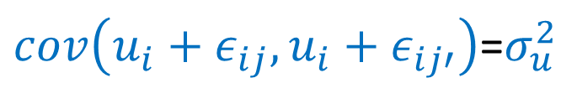
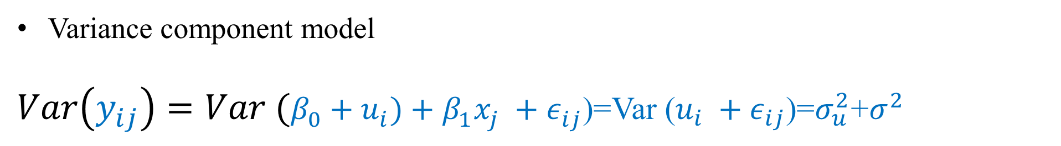
8.2 Linear mixed-effects models for repeated measures data
The random intercept model:
$$y_{ij} =(β_{0}+u_{i})+β_{1}x_{j} +ε_{ij}$$
$u_{i}\sim N\left(0,σ_{u}^{2}\right),ε_{ij}\sim N\left(0, σ^{2}\right),cov\left(u_{i},ε_{ij}\right)=0, cov\left(u_{i},x_{j}\right)=0$, $cov\left(ε_{ij},x_{j}\right)=0$
Variance component model
$Var\left(y_{ij}\right)=Var (β_{0}+u_{i})+β_{1}x_{j} +ε_{ij}$)=Var ($u_{i} +ε_{ij}$)=$σ_{u}^{2}\text{+}σ^{2}$
Within subject component
Between subject component
$cov\left(u_{i}+ε_{ij},u_{i}+ε_{ij′}\right)$=$σ_{u}^{2}$
$cor\left(u_{i}+ε_{ij},u_{i}+ε_{ij′}\right)$=$σ_{u}^{2}/(σ_{u}^{2}\text{+}σ^{2}$)
The covariance or correlation between pairs of repeated measurements

Slide 18

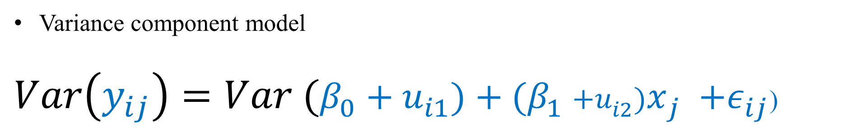
8.2 Linear mixed-effects models for repeated measures data
The random Slope and intercept model:
$$y_{ij} =(β_{0}+u_{i1})+(β_{1}{++u_{i2})x}_{j} +ε_{ij}$$
$u_{i}\sim N\left(0,σ_{u}^{2}\right),ε_{ij}\sim N\left(0, σ^{2}\right),cov\left(u_{i},ε_{ij}\right)=0, cov\left(u_{i},x_{j}\right)=0$, $cov\left(ε_{ij},x_{j}\right)=0$
Variance component model
$Var\left(y_{ij}\right)=Var (β_{0}+u_{i1})+(β_{1}{+u_{i2})x}_{j} +ε_{ij}$)

Slide 19


8.2 Linear mixed-effects models for repeated measures data
$$y_{ij} =(β_{0}+u_{i})+β_{1}x_{j} +ε_{ij}$$
The random intercept model:
$$y_{ij} =(β_{0}+u_{i1})+(β_{1}{++u_{i2})x}_{j} +ε_{ij}$$
The random Slope and intercept model:

Slide 20
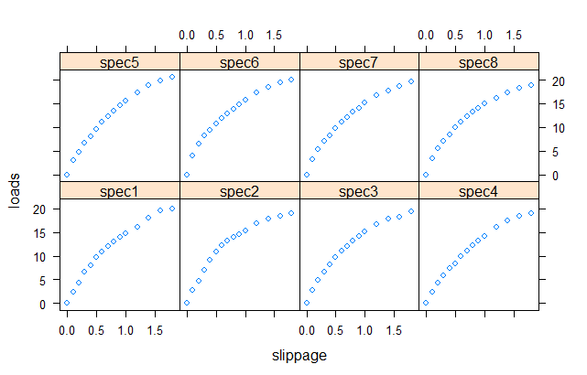
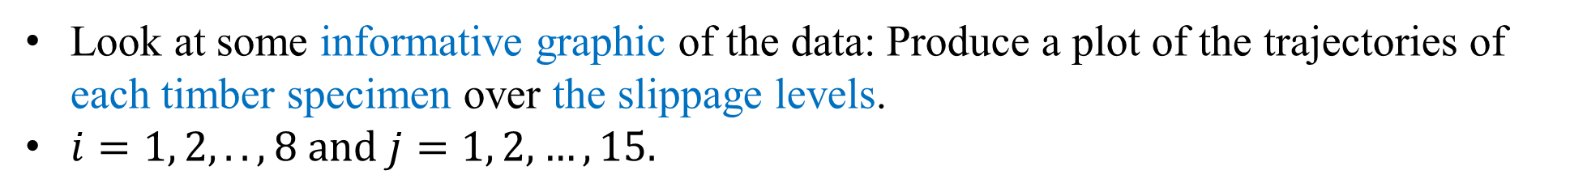
Example
Look at some informative graphic of the data: Produce a plot of the trajectories of each timber specimen over the slippage levels.
$i=1, 2, ..,8 and j=1, 2, …, 15.$
xyplot(loads~slippage | specimen, data = timber, layout = c(4, 2))
The plot is based on Simple LG
The loads increase when slippage level increase, with the increase gradually leveling off. This explains the large slippage effect found earlier.

Slide 21
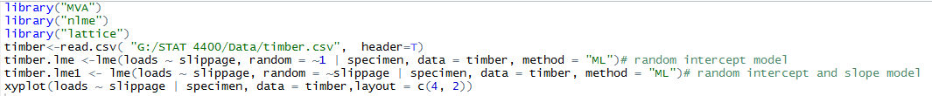
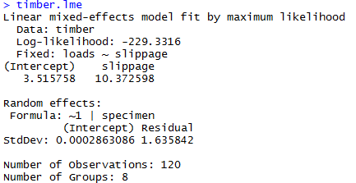
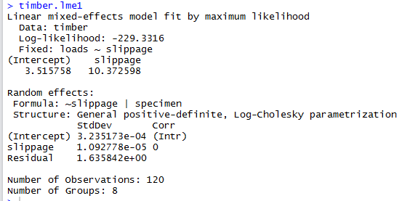


$$y_{ij} =(β_{0}+u_{i})+β_{1}x_{j} +ε_{ij}$$
$$y_{ij} =(β_{0}+u_{i1})+(β_{1}{++u_{i2})x}_{j} +ε_{ij}$$

